Slide 1
Chapter 11
Multicollinearity

Slide 2
Recap
When the predictors are correlated or express near-linear dependencies, we face the problem of multicollinearity
The primary sources of multicollinearity
  The data collection method employed
  Constraints on the model or in the population
  Model specification
  An overdefined model

Slide 3
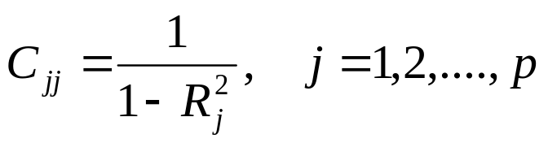
Effects of multicollinearity
Strong multicollinearity results in large variances and covariances for the least squares estimates
Recall under unit length scaling, the diagonal elements of the C=(X’X)⁻¹ can be written as
Where R_{j}² is the coefficient of determination from the regression of X_{j} on the remaining p-1 predictors
C_{jj} is also called the Variance Inflation Factors (VIF)

Slide 4

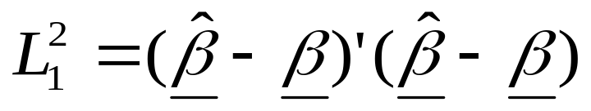
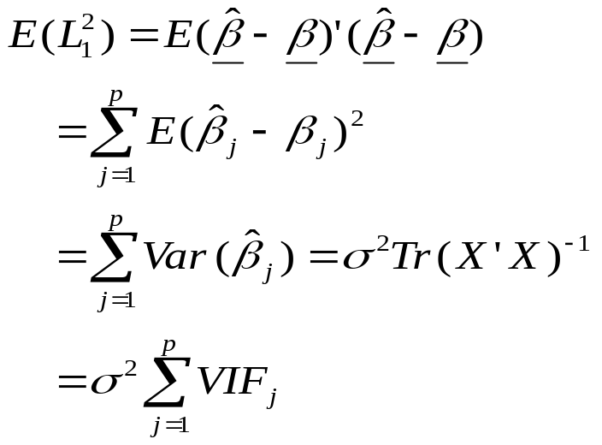
VIF
To note the role of VIF in estimation, write the squared distance from to the true parameter vector β as
Taking the expected value

Slide 5
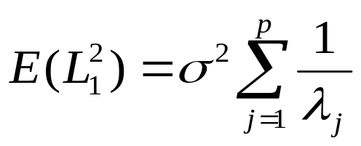
Note
Note that E(L₁²), which is pσ² for orthogonal system of predictors, is greatly magnified by large VIFs
Because trace of a matrix is also the sum of the eigenvalues, we can write
Where λ_{j}>0, j=1,2,…..,p are the eigenvalues of X’X.
If multicollinearity exists, then some λ_{j} will be smaller making the expectation larger.

Slide 6
Indicators of collinearity
Rule of thumb:
  Simple correlation r_{ij} > 0.95
  Variance inflation factors, VIF > 10

Slide 7
Body fat data
Recall the VIFs were (708.8, 564.3, 104.6) associated with the predictors SKIN, THIGH and ARM
That is, R² of (0.999, 0.998, 0.990) for regressing each of the predictors on the remaining two predictors

Slide 8
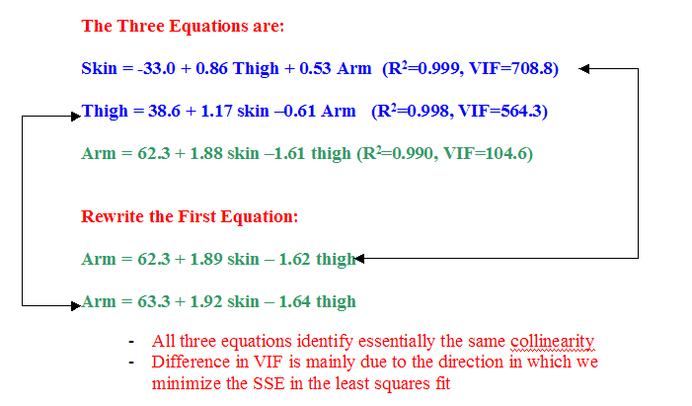
Body fat data

Slide 9
More on eigenvalues
Recall that, if A is a pxp symmetric matrix with n eigen values λ₁, λ₂,…,λ_{p} and p associated eigen vectors v₁,v₂,….,v_{p}, then the following algebraic relationship is true
Av_{j} = λ_{j}v_{j}, j=1,2,….,p
Suppose an eigenvalue of W’W, while not exactly zero, is very close to zero
Since all the elements of a eigen vector are less than 1.0 in magnitude, λ_{j}v_{j}≈0 for small eigen values

Slide 10
Eigenvalues
It now follows that
W’Wv_{j}=λ_{j}v_{j}≈0
for any eigen vector whose corresponding eigen value is nearly zero
Pre-multiply the above equation by v_{j}’ and get v_{j}’W’Wv_{j}≈0.
Now let U=Xv_{j} making the above equation U’U=0=ΣU_{r}²

Slide 11
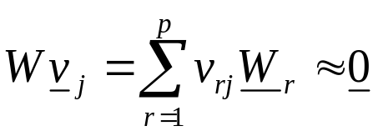
Eigenvalues
Since all terms in the summation are non-negative, U’U=0 implies U=0.
Thus if λ_{j}≈0 (near collinearity), then
Implication from the above equation is that the elements of eigen vectors corresponding to small eigen values provide coefficients that define multicollinearities among the predictor variables
  The larger elements in the eigen vector will indicator which variables are involved in the collinearity

Slide 12
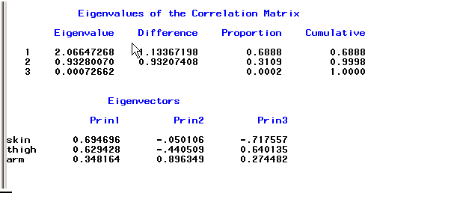
Fat Data
smallest
Eigenvector corresponding to the smallest eigenvalue

Slide 13
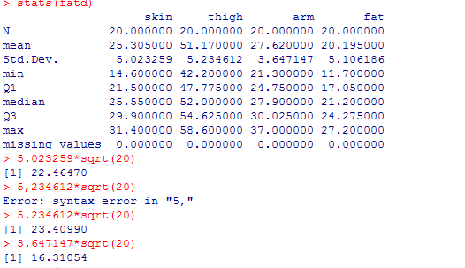
Fat Data

Slide 14
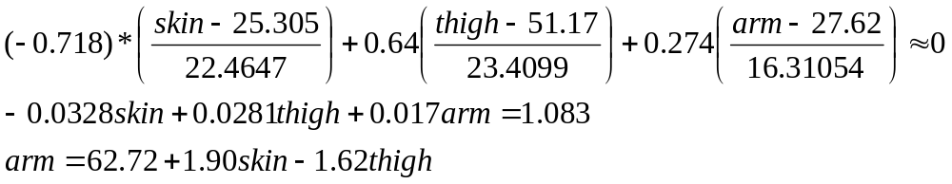
Fat data
Based on the eigenvector, the following relation in terms of the standardized variable is true:
-0.718 skin+0.640 thigh+0.274 arm≈0
In terms of the original predictors, this relation is
Unit length scaled
Close to the equation previously seen

Slide 15
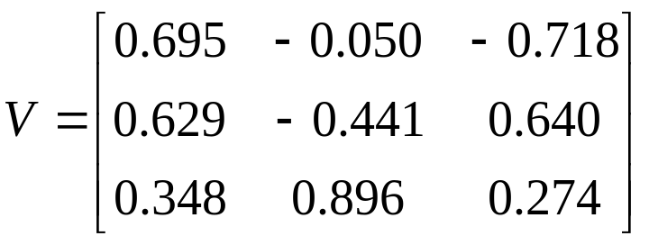
Note
Write the matrix of eigenvectors as
A graphical illustration of the collinearity may be obtained by plotting the data in terms of the new predictors z_{j}=w_{i}’v_{j}
These variables are called the principal components.

Slide 16
Note
V, an orthogonal matrix, describes a rotation of the original coordinate axis into new coordinates defined by the principal components.
Define a transformed data matrix as Z=WP. Scatter-plots of the pairs of columns of Z are principal component plots (PCP)
PCPs are analogous to scatter plots but useful in revealing collinearities

Slide 17

R code for PC

Slide 18
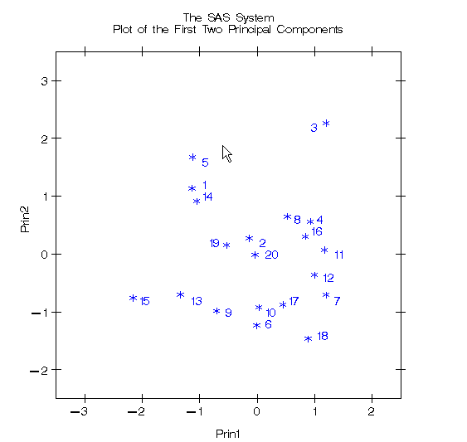
Fat Data

Slide 19
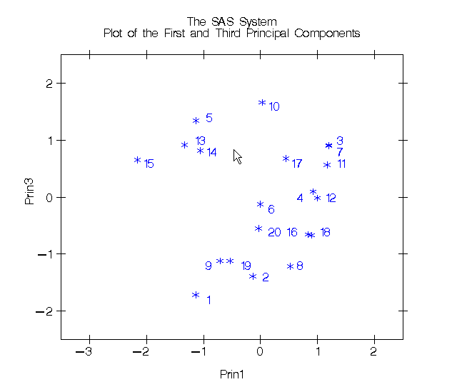
Fat Data

Slide 20
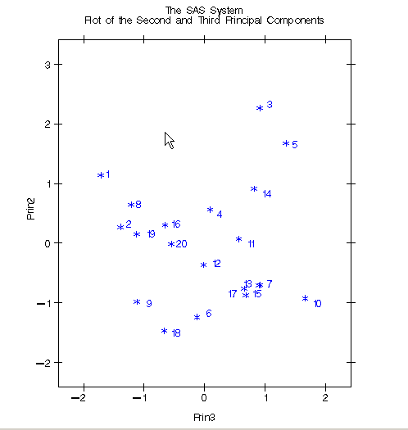
Fat Data

Slide 21
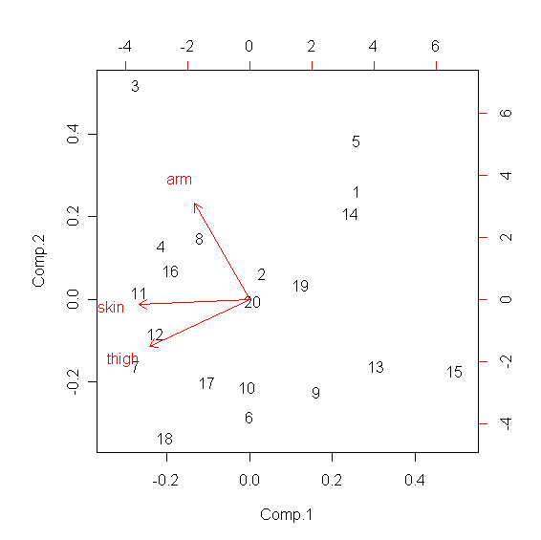
Fat Data

Slide 22
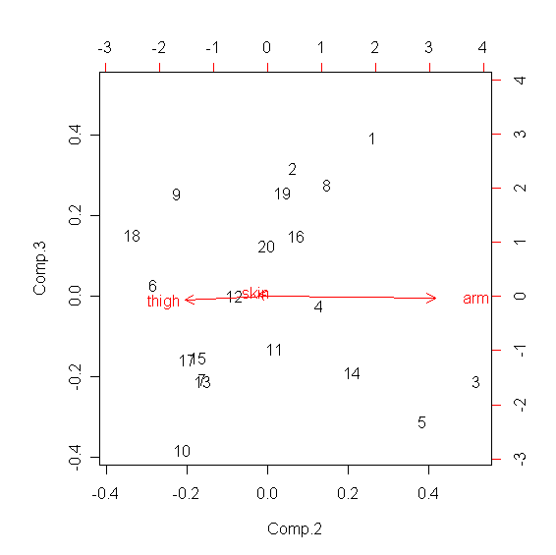
Fat Data

Slide 23
Fat data
Based on the eigenvector, the following relation in terms of the standardized variable is true:
-0.718 skin+0.640 thigh+0.274 arm≈0
In terms of the original predictors, this relation is
Unit length scaled
Close to the equation previously seen

Slide 24
Note
Write the matrix of eigenvectors as
A graphical illustration of the collinearity may be obtained by plotting the data in terms of the new predictors z_{j}=w_{i}’v_{j}
These variables are called the principal components.

Slide 25
Note
V, an orthogonal matrix, describes a rotation of the original coordinate axis into new coordinates defined by the principal components.
Define a transformed data matrix as Z=WP. Scatter-plots of the pairs of columns of Z are principal component plots (PCP)
PCPs are analogous to scatter plots but useful in revealing collinearities

Slide 26
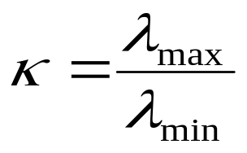
Criteria for collinearity
If the predictors are orthogonal, all the eigenvalues are one
  Suggests that the value of λ_{min} relative to one might be used
Since the sum of the eigenvalues is equal to p, a matrix with small eigenvalues will also have some large ones.
Define the condition number (measure of the spread in the eigenvalue spectrum) of the X’X matrix as

Slide 27
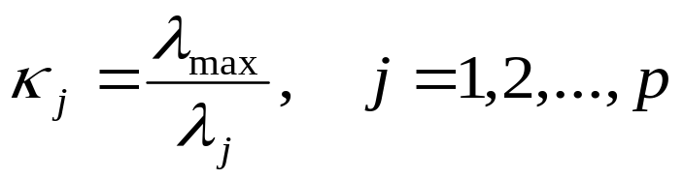
Collinearity
If κ is less than 100, there is no serious problem with multicollinearity
If κ is between 100 and 1000, it implies moderate to strong multicollinearity
  If > 1000, it indicates severe collinearity
The condition indices of the X’X are defined as

Slide 28
Collinearity
The number of condition indices that are large (say >=1000) is a useful measure of the number of near-linear dependencies in X’X
For the Fat data,
κ₁=1, κ₂=2.066/0.932=2.217
κ₃=2.066/0.0007=2951.429
One strong linear dependency

Slide 29
Methods for dealing with multicollinearity

Slide 30
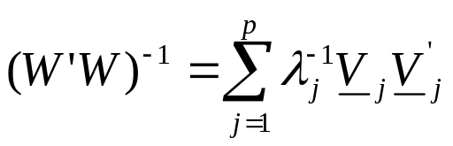
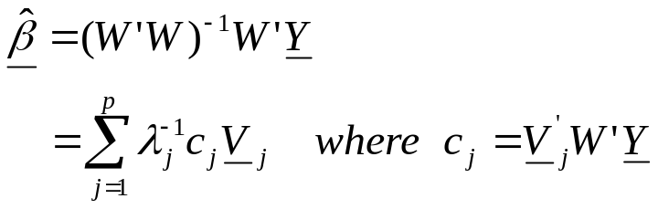
Ridge Regression
Motivation
Recall that we can write (W’W)⁻¹ in terms of eigenvalues and eigenvectors as
Now we can write the least squares estimate as
Equation 1

Slide 31
Motivation
Note that unless c_{r} is near zero, small eigenvalues of W’W produce large multipliers λ_{j}⁻¹ on the corresponding eigenvectors.
  Consequently, multicollinear predictor variables, those with large elements in V_{j} that have small eigenvalues, will receive large weights in the above equation
  Also, signs on these coefficient estimates tend to have the same pattern as the signs in the V_{j}

Slide 32
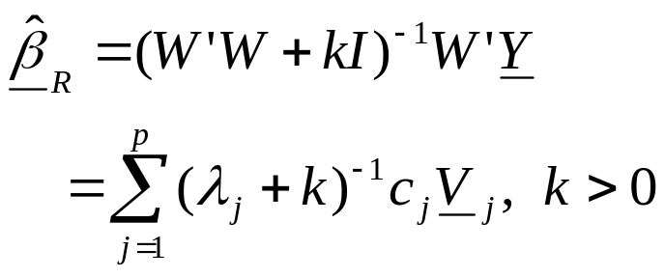
Motivation
Ridge regression alters the influence of all the eigenvectors by reducing the coefficients in the above equation
  This is accomplished by adding a small constant k to the diagonal elements of W’W before inverting
Define the ridge estimator as
Equation 2

Slide 33


Remarks
By adding a small k makes W’W to be invertible
By adding a small k to the small eigenvalues, the influence of eigenvectors identifying collinearities can be greatly reduced over than of equation (1)
If k is sufficiently small, only very small eigenvectors will be appreciably altered in equation (2)
  That is, eigenvectors with moderate or large eigenvalues will have approximately the same influence
  in since for these roots

Slide 34
Remarks
A suitably chosen small k will not only reduce the effect collinearity but also will make the estimate closer to the parameter than the least squares estimate
  Theoretically one can show that for every regression model there does exist a range of values for k, known as the ridge parameter, that guarantees that the ridge estimator is more accurate than least squares

Slide 35
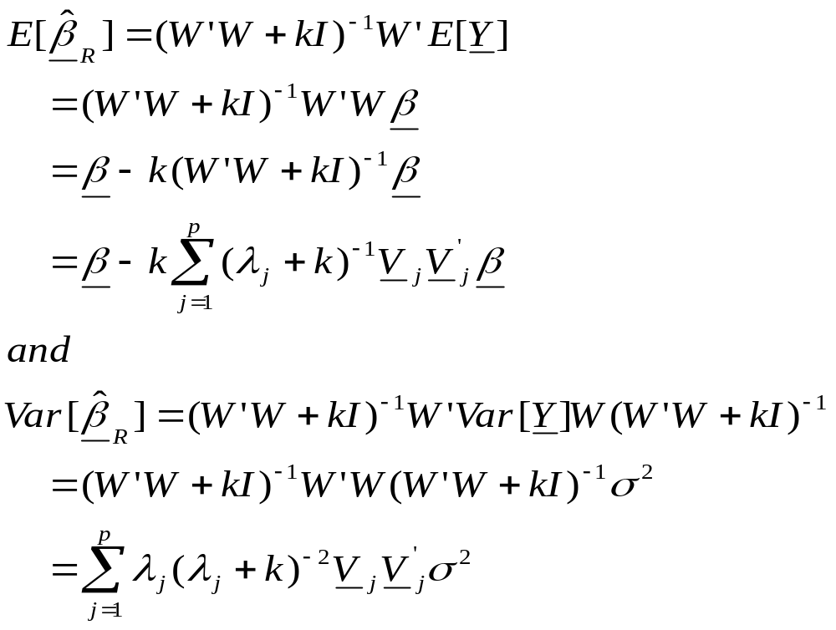
Ridge Estimate
Show now that

Slide 36
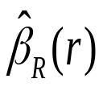
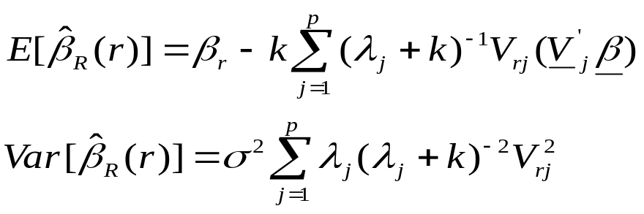
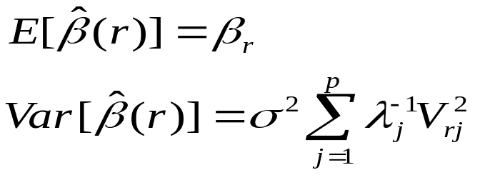
Ridge Estimate
For an individual parameter estimator,
the mean and the variance can now be written as
Compare these to that of the least squares estimate

Slide 37
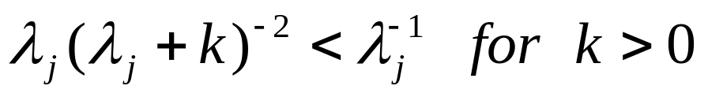
Ridge vs Least Squares
Ridge estimates are biased but have smaller variances than least squares since
The key to the tradeoff to be successful is to determine the appropriate ridge parameter k.

Slide 38
Ridge Trace
Graphical presentation useful for choosing the ridge parameter k
This is a plot of the elements of versus k for values of k usually in the interval [0,1]
Some coefficient estimates for multicollinear predictor variables will change very rapidly as k is increased from zero and may even change sign.
These sign and magnitude changes, while dramatic initially, soon stabilize and change only gradually thereafter.
Coefficient estimates for non-multicollinear variables do not change dramatically, only gradually, as k is increased from zero.
A value of k is selected when the estimates for the multicollinear predictor variables first stabilize and change gradually like the non-multicollinear variables.

Slide 39
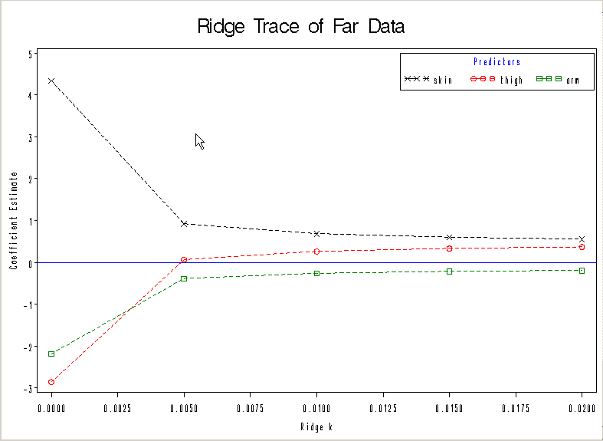
Fat Data

Slide 40
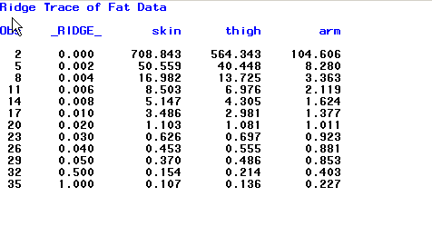
VIF – Fat Data

Slide 41
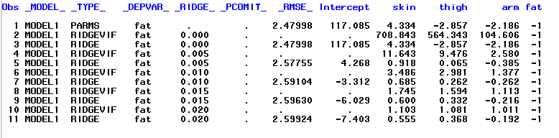
Coefficient Estimates

Slide 42
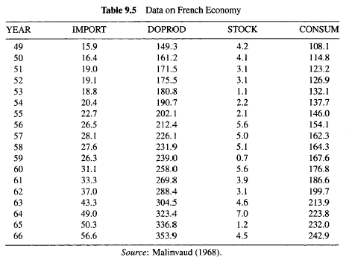
French Import Data

Slide 43
French Import Data
Import activity in French economy (all in billions in French francs)
  Import (response variable)
  Domestic production
  Stock formation
  Domestic consumption

Slide 44
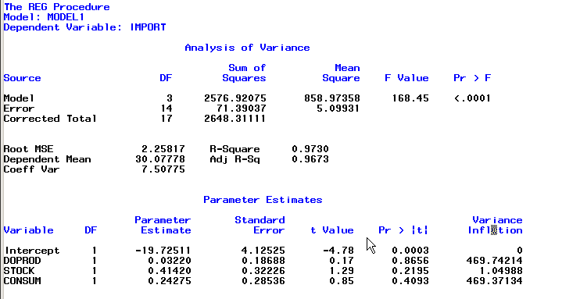
Regular Fit

Slide 45
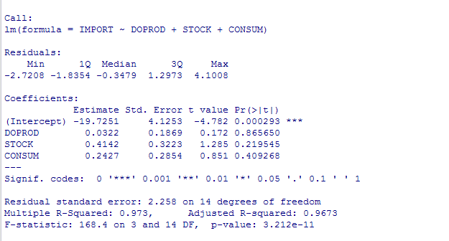
French Import Data
bothersome
OK

Slide 46
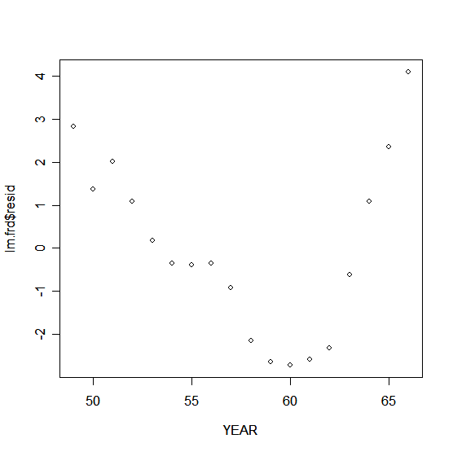
Index plot of residuals

Slide 47
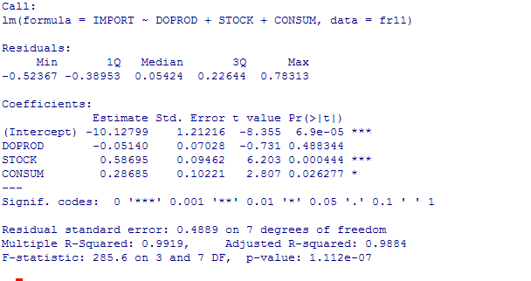
French data (1949-’59)
Looks good

Slide 48
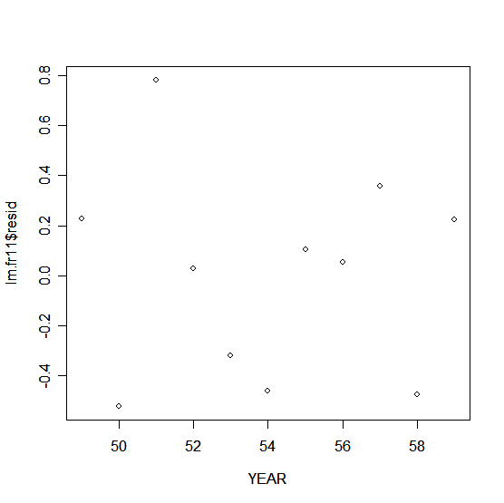
Residual plot (’49-’59)

Slide 49
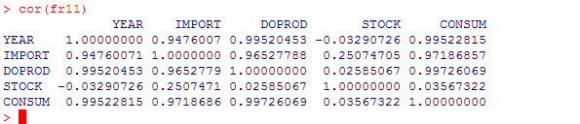
Multicollinearity

Slide 50
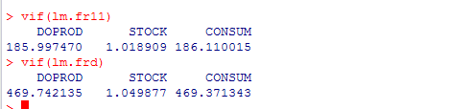
VIF
11 years
Complete dataset

